Slide 1
Lab 4: Advanced cpu design
CG3207 computer architecture
AY2022-2023 Semester 1
Week 10, Animesh Gupta

Slide 2
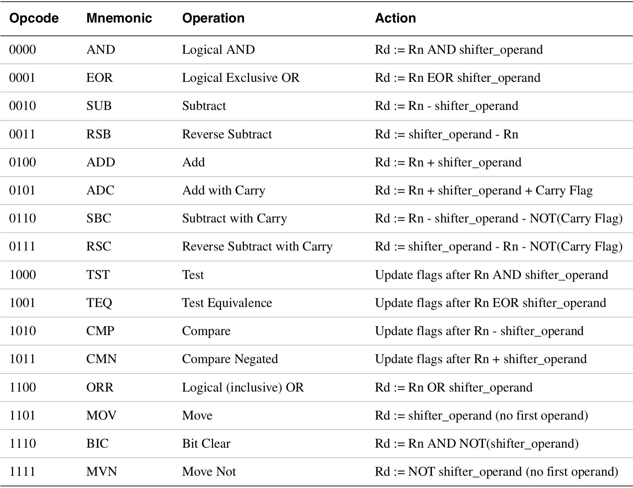
CG3207 Lab 4 (Week 10): Advanced CPU Design
After Lab 3, you should already have the:
Instruction Type | Instructions | Remarks
Memory Instructions | LDR, STR | with positive immediate offset
 |  | with negative immediate offset (optional)
Data Processing Instructions | AND, OR, ADD, SUB | with Register or immediate as Src2
 |  | with register Src with shifts (LSL, LSR, ASR, ROR) (optional)
 | CMP, CMN | (optional)
 | MUL, division (MLA) | Unsigned 32-bits by 32-bits
Branch Instructions | B | Unconditional Branch
 | B{cond.} | Conditional Branch
Integrated ARM processor that supports the following instructions:
In Lab 4, you are going to:
Expand your ARM processor to support all the 16 DP instructions:

Slide 3
CG3207 Lab 4 (Week 10): Advanced CPU Design
Basic requirements of Lab 4 (max. 15 marks):
Mainly modify the ALU and the ALU Decoder.
The C flag has to be an output from the CondLogic component/module, to act as an input for the ALU component/module (to support ADC instruction).
Implement the processor efficiently, e.g. minimizing the additional adders.
You may by-pass the MCycle for lab 4.
Both HDL simulation and hardware demonstrations are required.
You may either write your own assembly program to use LEDs / 7-Segments / Pushbuttons /Switches, or modify the HelloWorld.s and use UART.

Slide 4

CG3207 Lab 4 (Week 10): Advanced CPU Design
Open-ended Enhancements (max. 10 marks):
Additional Instructions or features of instructions which are not completely implemented.
Marks will be given depending on how much additional logic you need to incorporate for the additional instructions

Slide 5
CG3207 Lab 4 (Week 10): Advanced CPU Design
Possible Enhancements (max. 10 marks):
Implement additional instructions or features of instructions that are not completely implemented
Like support Src2 for DP instruction with rotated immediate
Pipelining with or without hazards hardware
Marks will be given depending on the complexity of pipelined processor implemented, e.g. control of different hazards
Implement some kind of exception handling/support for interrupts
Other enhancements
Marks will also be adjusted depending on students’ QnA performance

Slide 6
CG3207 Lab 4 (Week 10): Advanced CPU Design
Lab 4: Expected Outcome
You should fully understand the operation of all DP instructions, and be able to describe the flow of instruction processing in your ARM processor
You should understand the practical use of each DP instruction, difference between similar instructions.
You should be able to describe all the modifications you have done in your processor from lab2 to support the additional DP instructions.
If you implement pipelined processor, you should familiar with its principle and datapath, be able to locate the result for certain instruction on the waveform;
If you implement pipelining with hazards control, you should be able to explain its working principle.

Slide 7
CG3207 Lab 4 (Week 10): Advanced CPU Design
The end

